Slide 1

Recognition of Human Arm Gestures Using Myo Armband for the Game of Hand Cricket
Karthik Sivarama Krishnan (MS - EE)
Akash Saha (MS - EE)

Slide 2
The Game of Hand Cricket
Hand cricket is widely popular among the Teenagers in Indian sub-continent and other neighboring countries.
It is played through gestures (called 'throws’).
Similar to the game of Rock-Paper-Scissors.

Slide 3
Hand Cricket Playing Rules
Each player throws a particular finger gesture for the numbers one, two, three, four and six.
The individual scores of both the players is calculated by adding the present gesture value to the previous one
The game continues until both the players throw the same gesture
After the game ends we add the score of the individual players
The player with highest score wins.

Slide 4
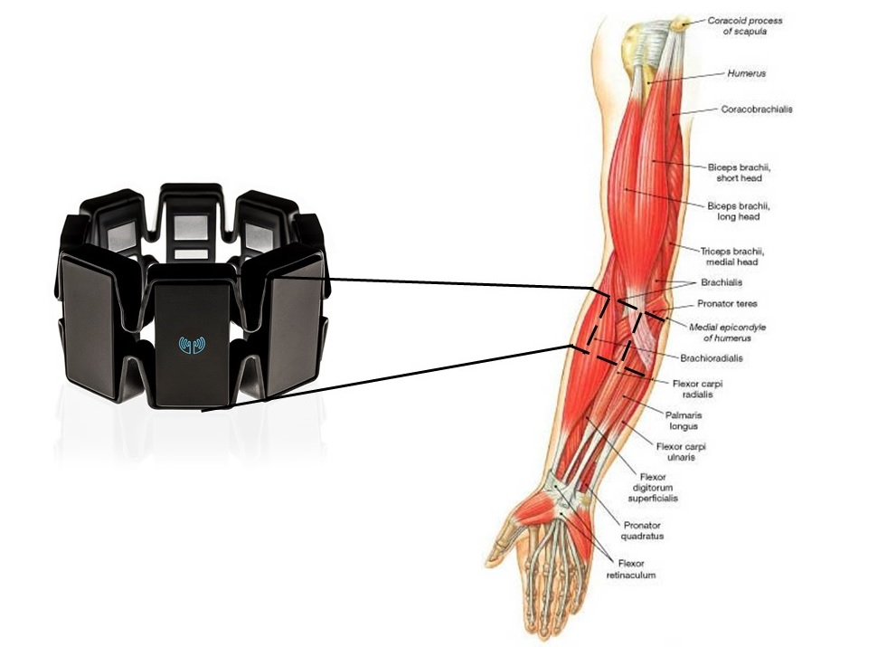
Location of the Myo-Arm Band on the Human
Arm
Myo Arm-Band with 8 channels
It records the EMG signals.
Electrodes on the channel records the movement of the muscles and their changes

Slide 5
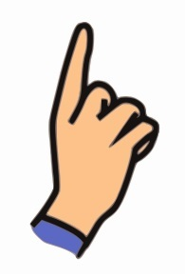
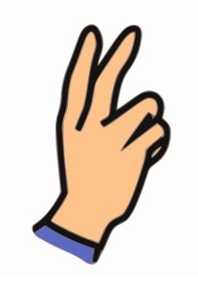
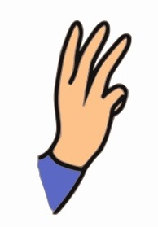
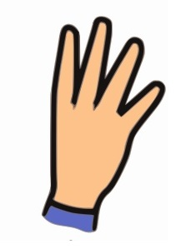

Permissible Gestures
One Two Three Four Six

Slide 6
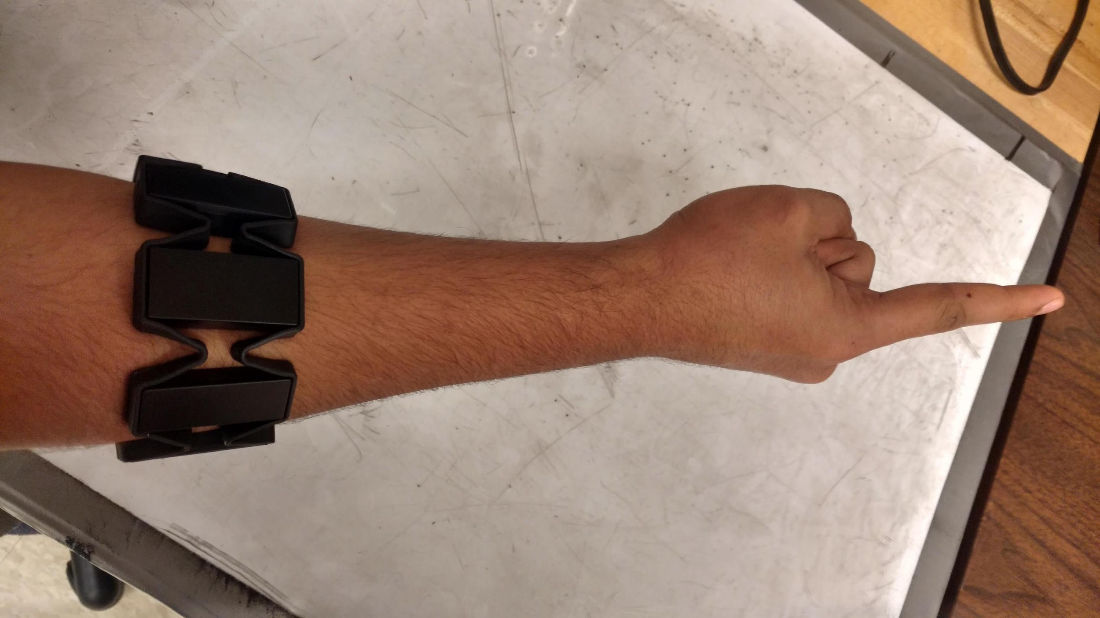
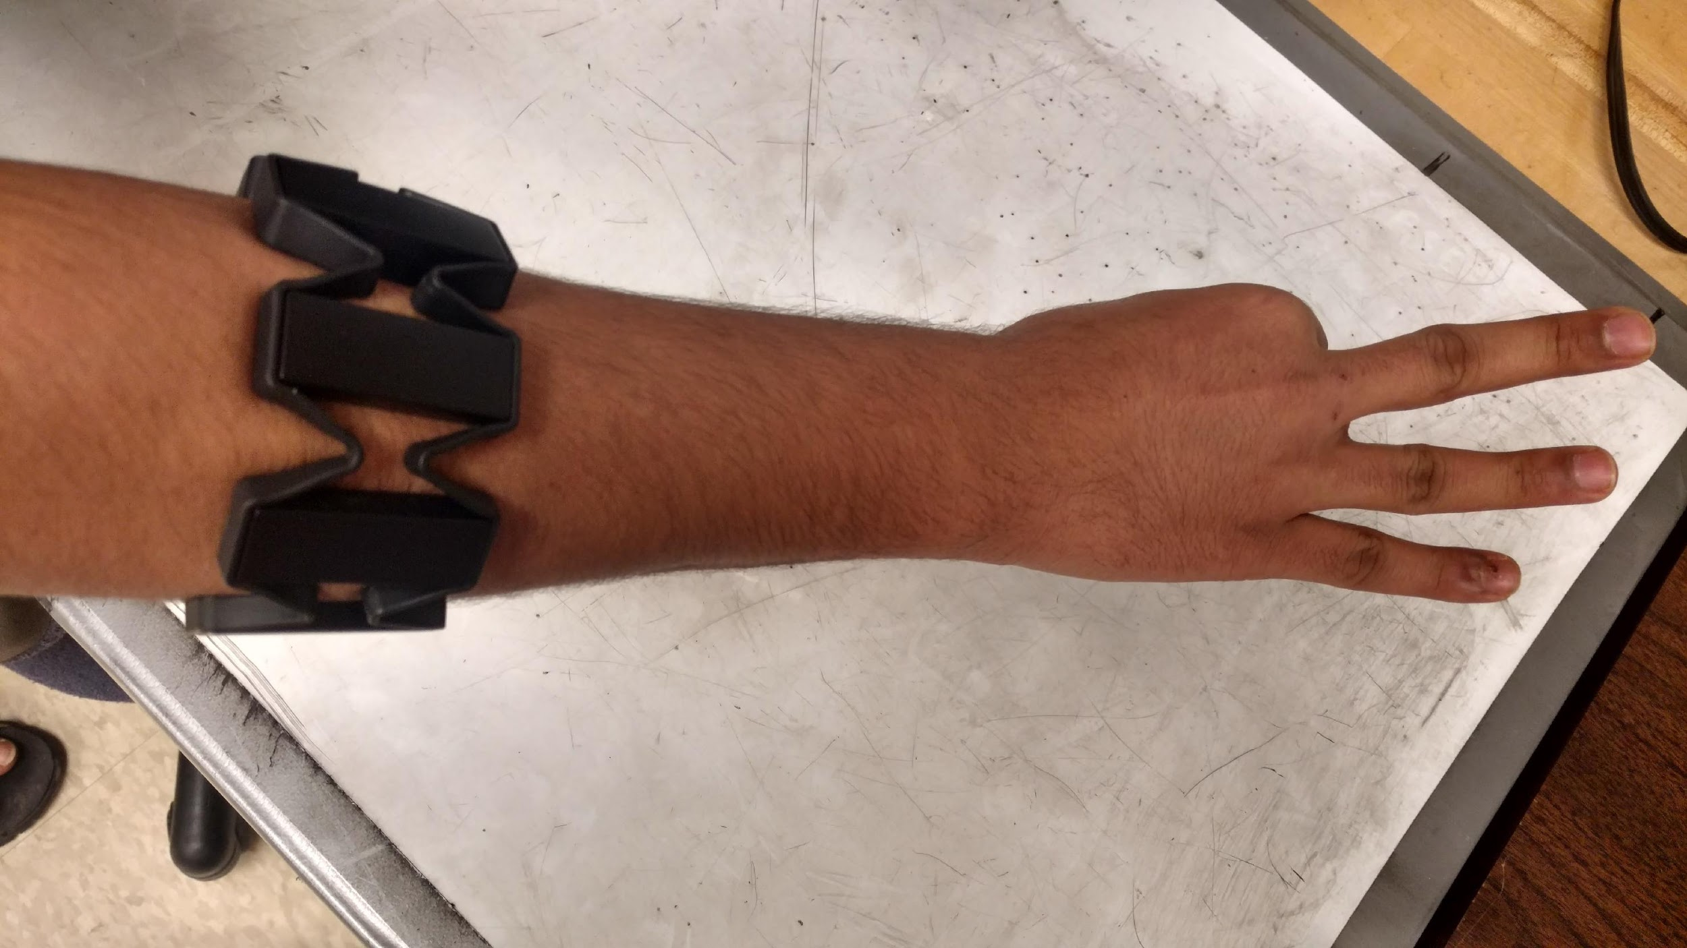
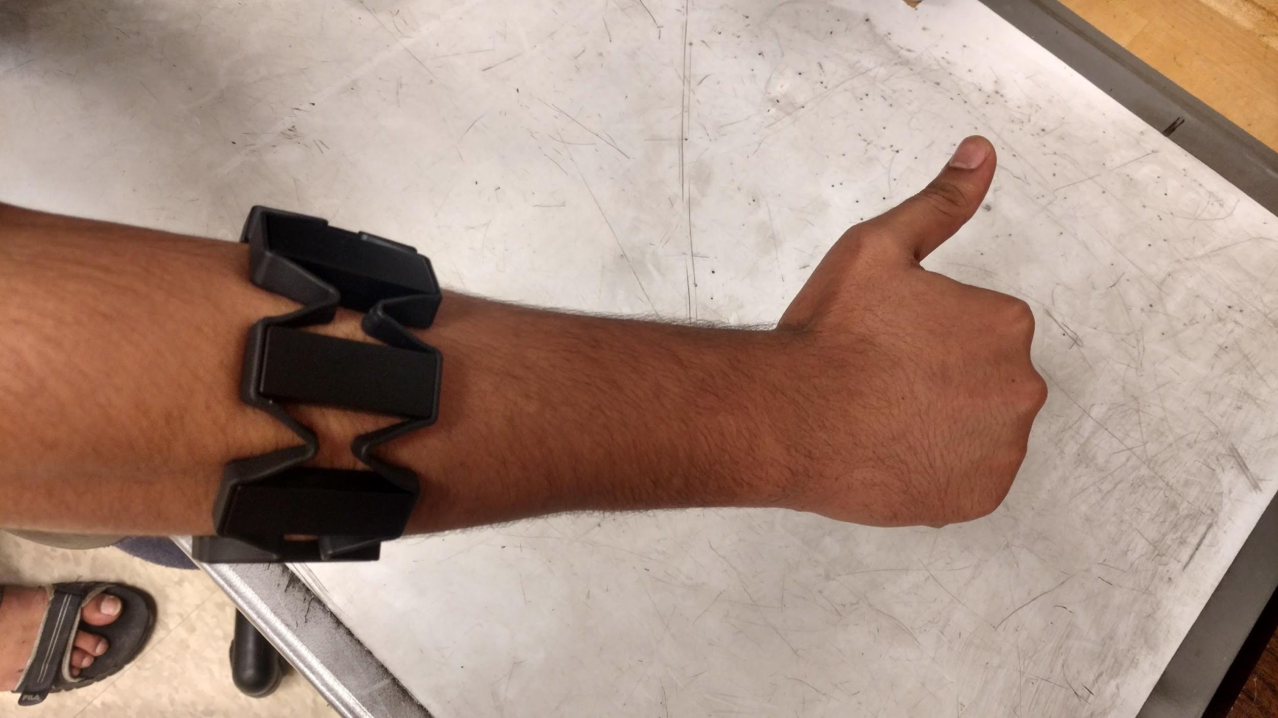
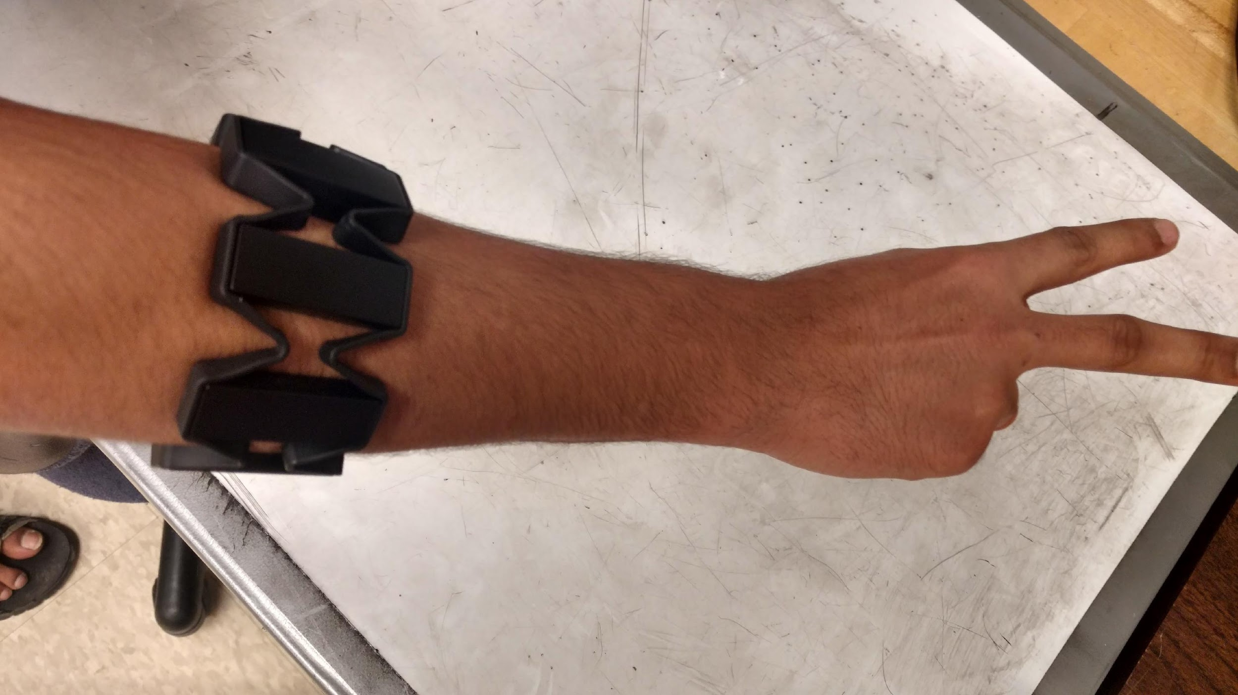
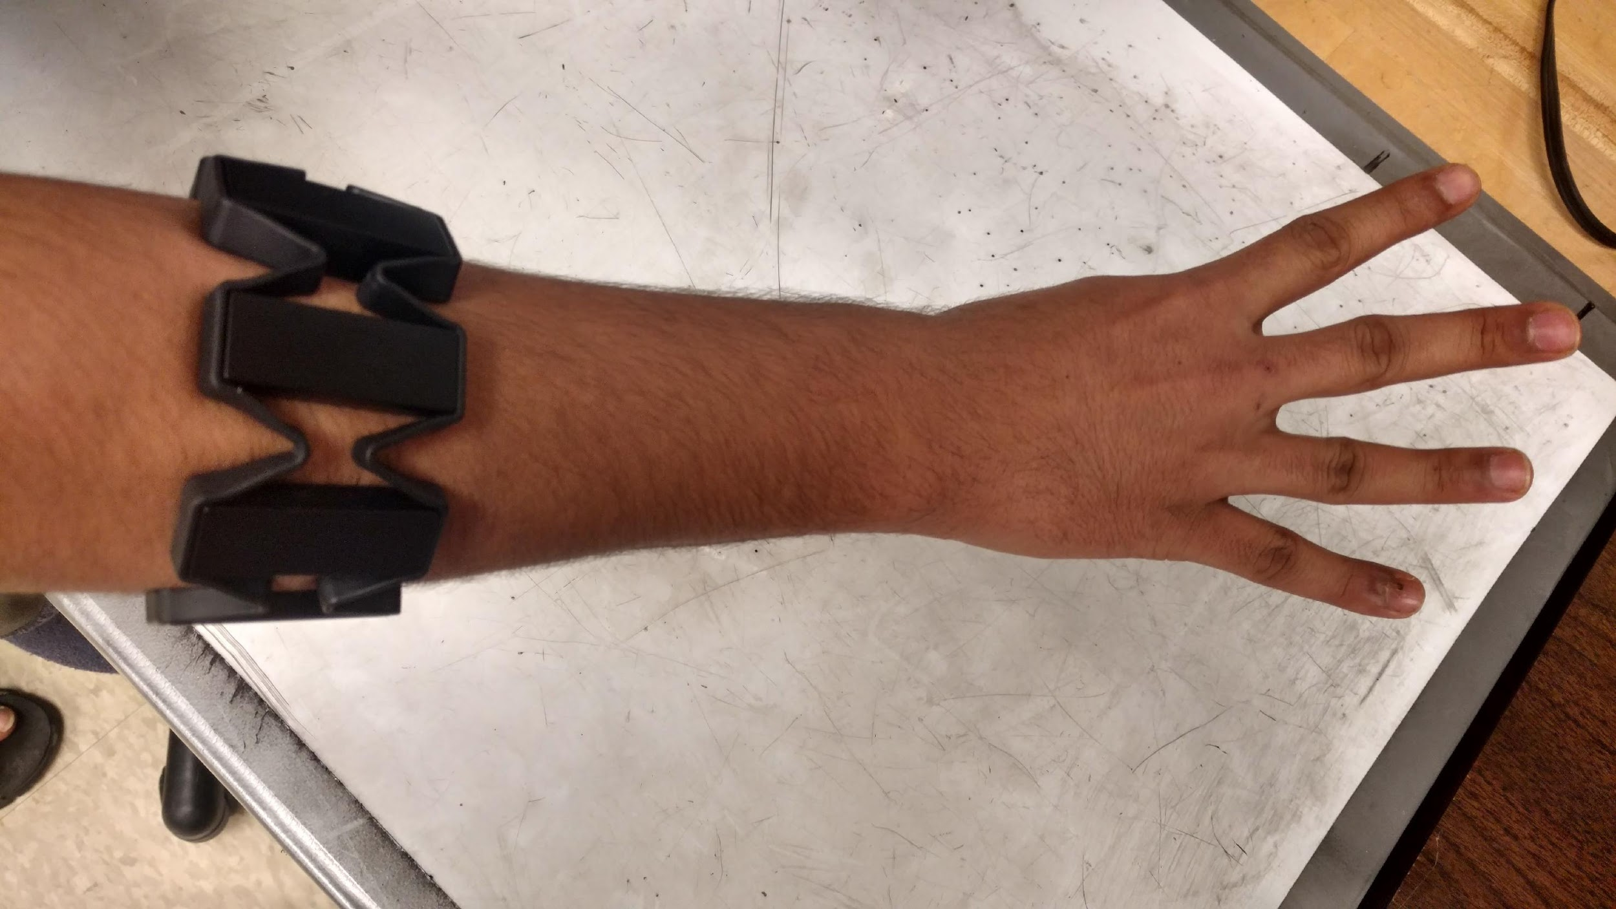
Placement of the Myo Arm Band

Slide 7
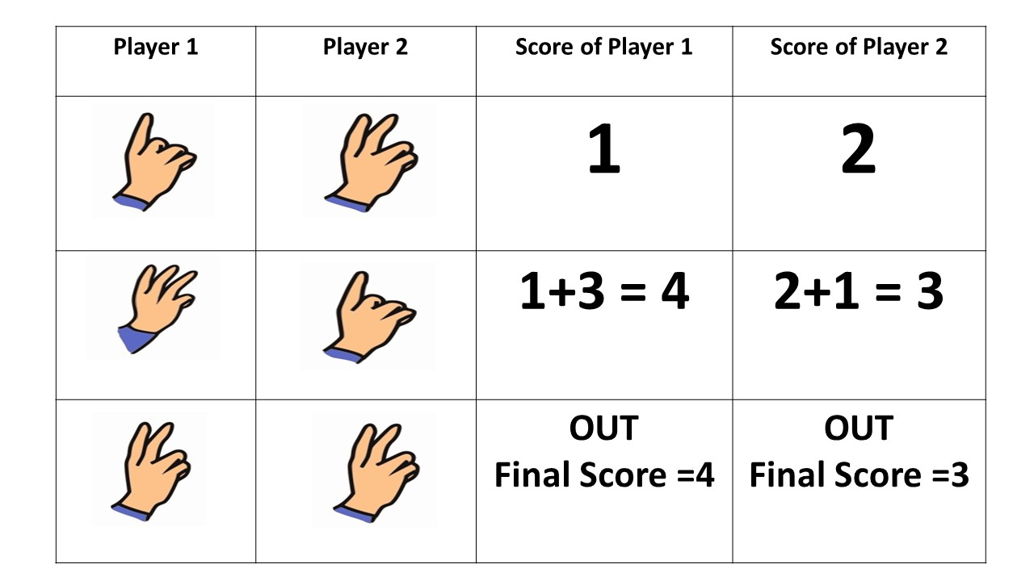
Gameplay demo between Players
We notice
that the
Player 1
scored
higher
than
Player 2. So
this implies
that
Player 1 has
won
the game

Slide 8
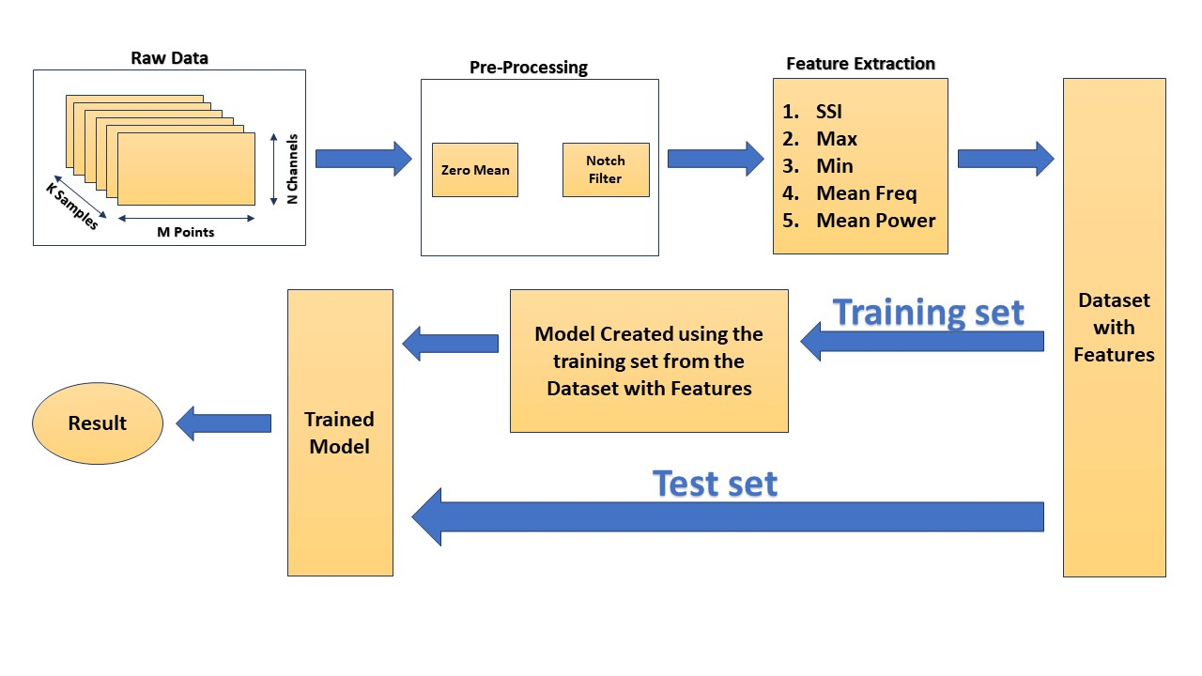
Proposed Approach Algorithm for Gesture Recognition

Slide 9
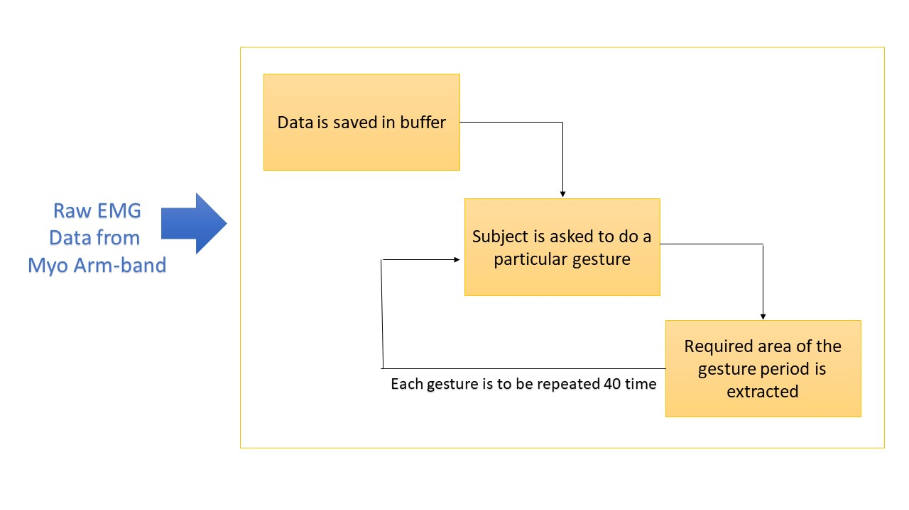
Data Collection

Slide 10
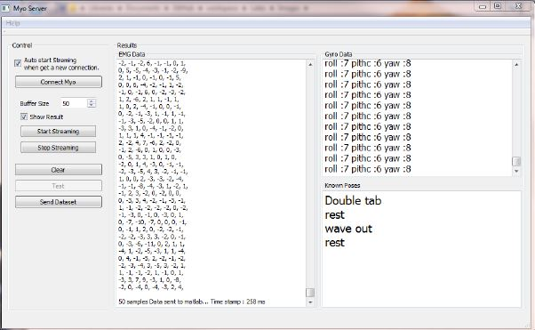
Data Collection – Contd.
The Myo Arm Band Server that actually helps is sending data from the myo arm band to Matlab where all the computational details are carried out

Slide 11
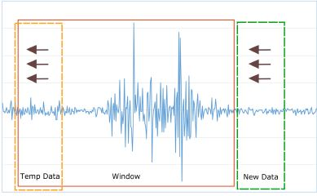
Data Collection – Contd.
The EMG signal data when plotted appears as shown beside
The window represents the section where the finger gesture as actually made

Slide 12
Filtering and Pre-Processing
Notch Filter: Removes the 60Hz noise component.
DC-offset Removal: Mean value of the waveform, source of distortion.

Slide 13


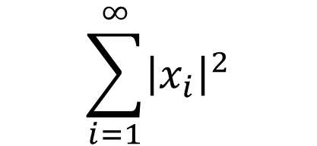
Features
Maximum Value ->
Minimum Value ->
Mean Frequency ->
Mean Power ->
SSI – Simple Square Integral ->
max{X1 , X2 ,……., Xn}
min{X1 , X2 ,……., Xn}

Slide 14
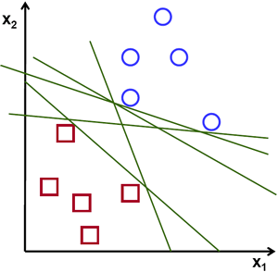
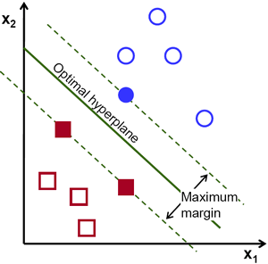
SVM Classification
Supervised Learning algorithm in Machine Learning
Represent the samples as points in space
Divides the points in separate group classes with gaps between them
The figure on the top represent the points before they have been classified by
SVM.
The second figure represents the SVM Classifier separating the two classes

Slide 15
SVM Classification – Contd.
Linear SVM
The datsaet is represented as follows:-
(x(1), y(1)), ………., (x(n) , y(n))
Here
y(i) = Class number
x(i) = P dimensional vector
Soft Margin was used to distinguish the classes as the number of classes was more than two and also some of the gestures were almost similar to each other like one and six

Slide 16
Results
 | SUBJECT 1 | SUBJECT 2
Initial - Linear SVM with Hold out Validation (20%) | 96% | 87.5%
Final - Mean and standard Deviation of accuracies after data shuffling | Mean 92.4% Standard Deviation 3.075 | Mean 84.27% Standard Deviation 3.3327

Slide 17
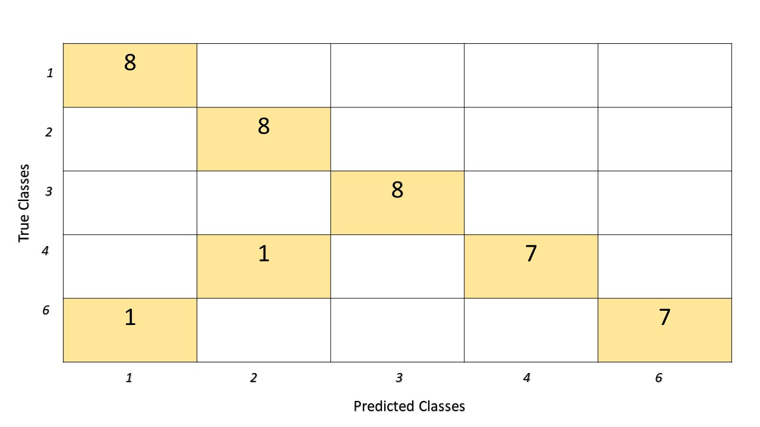
Confusion Matrix of Subject 1

Slide 18
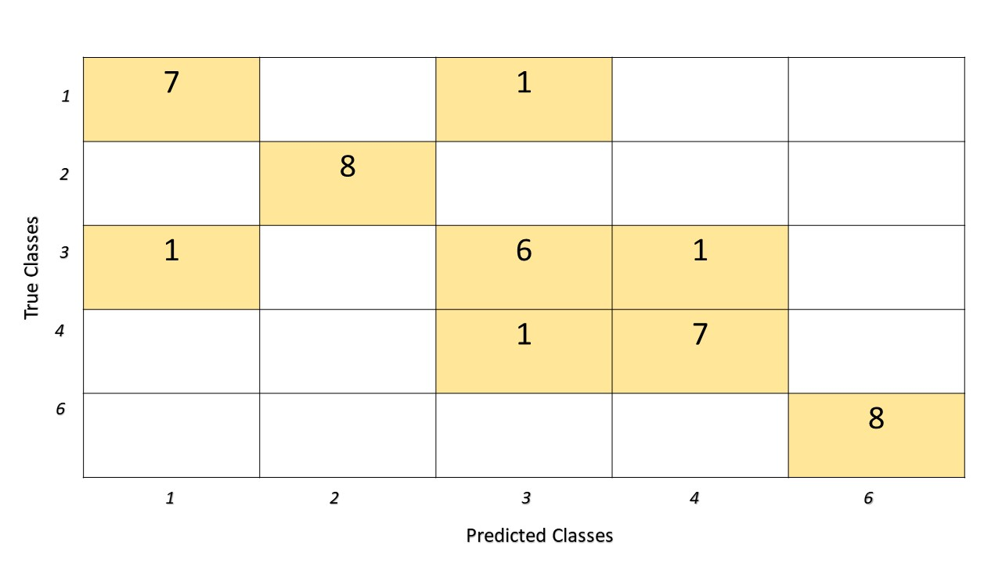
Confusion Matrix of Subject 2

Slide 19
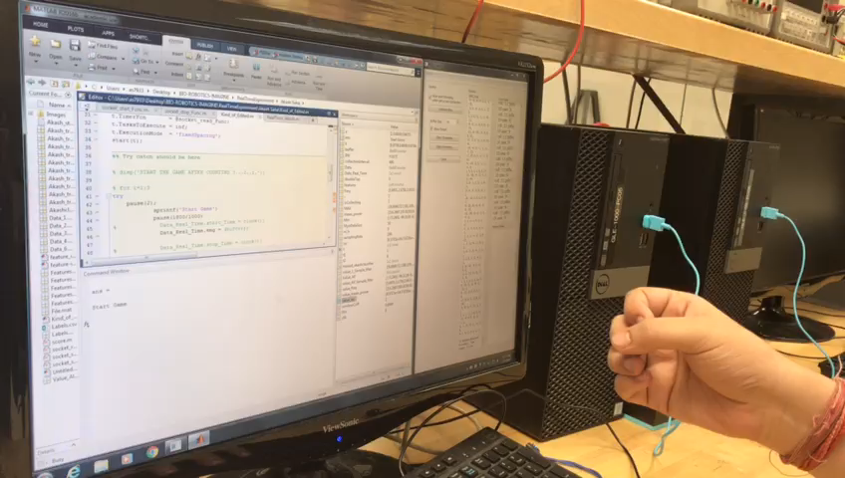
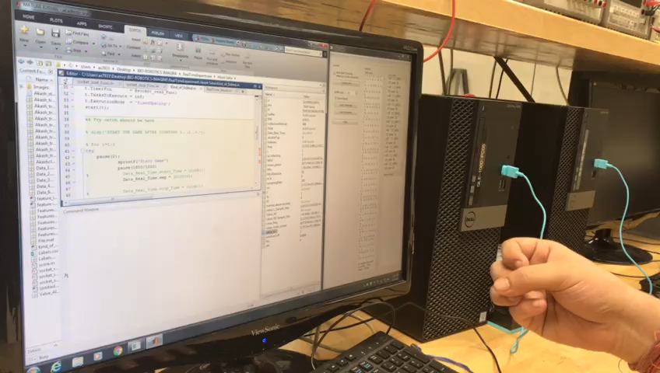
Video Representation

Slide 20
Limitations
The accuracy of the model would be altered with the number of classes being increased.
Time required for data collection is long and tedious.
The recognition is limited to particular gestures only but works with any subject
Future Work
Use of infra-red cameras to have a better understanding of the finger gestures
Implementing the same idea for American Sign Language communication or any other Sign language communication.
Use of deep learning to understand the gestures better.

Slide 21
Thank you

